Slide 1

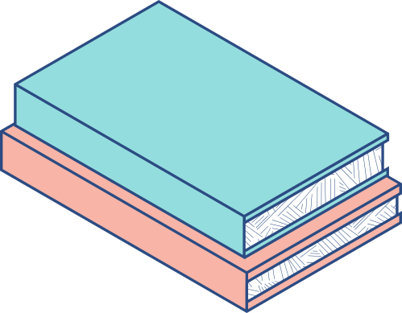




HANDWRITTEN RECOGNITION USING GENARATIVE ADVERSIAL NETWORKS

Slide 2
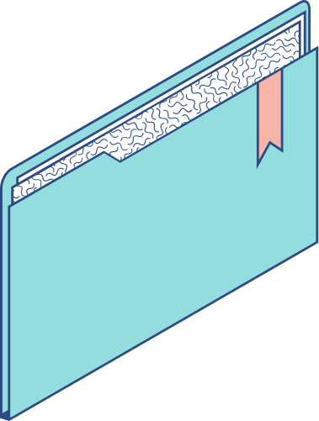
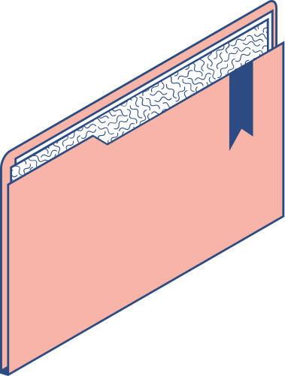
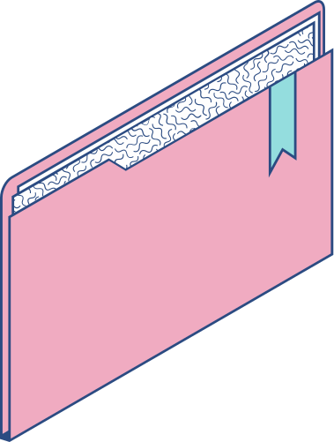
Outline
GENARATIVE ADVERSIAL NETWORKS OBJECTIVE REAL TIME APPLICATION GENEARTOR AND DISCRIMINATOR PROBLEM STATEMENT PROPOSED SYSTEM /SOLUTION SYSTEM DEVELOPMENT APPROACH ALGORITHM AND DEPLOYMENT RESULT CONCLUSION REFERENCE

Slide 3
GAN:
A Generative Adversarial Network (GAN) is a type of artificial intelligence model composed of two neural networks, the generator and the discriminator, which are trained simultaneously through a competitive process. The generator creates synthetic data samples, such as images, while the discriminator evaluates them for authenticity. Through this adversarial process, the generator improves its ability to produce realistic data, while the discriminator gets better at distinguishing between real and fake data. GANs have been widely used in various fields, including image generation, text-to-image synthesis, and data augmentation.

Slide 4
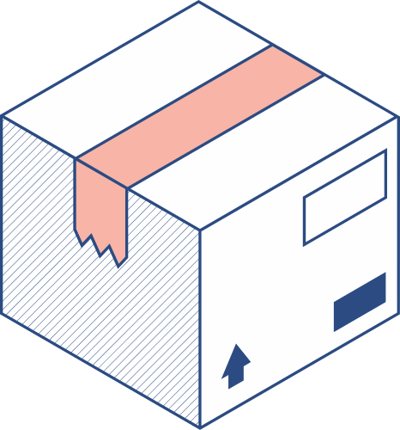

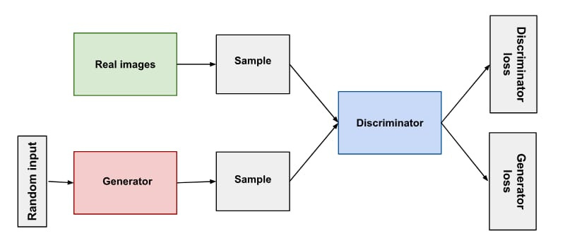
GAN ARCHITECTURE:

Slide 5
Objective:
The main objective of a GAN (Generative Adversarial Network) is to generate new data instances that resemble a given dataset.
It consists of two neural networks, a generator and a discriminator, which are trained simultaneously.
The generator creates fake data samples, while the discriminator tries to distinguish between real and fake samples.
Through this adversarial process, the generator improves its ability to produce realistic data, while the discriminator improves its ability to differentiate between real and fake data.

Slide 6
Real time application:
Image Generation
Video Generation and Enhancement
Style Transfer
Face Aging and Transformation
Anomaly Detection
Data Augmentation
Fashion Design and Virtual Try-On
Drug Discovery and Molecular Design

Slide 7

Generator:
The generator in a Generative Adversarial Network (GAN) is a neural network responsible for generating new data samples. It takes random noise or other input vectors as input and transforms them into data instances that resemble the training data. The goal of the generator is to produce data samples that are indistinguishable from real data to the discriminator, another neural network in the GAN framework.

Slide 8
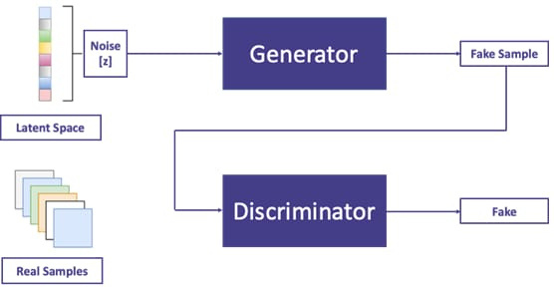

Slide 9

DISCRIMINATOR:
In a Generative Adversarial Network (GAN), the discriminator is another neural network whose role is to distinguish between real data samples and those generated by the generator network. The discriminator learns to classify input data instances as either real (from the true data distribution) or fake (generated by the generator).
The discriminator typically consists of one or more layers of neural network units, often employing architectures such as convolutional neural networks (CNNs) or feedforward neural networks. During training, the discriminator learns to differentiate between real and fake samples by optimizing its parameters through backpropagation and gradient descent, while competing with the generator network.

Slide 10
PROBLEM STATEMENT :
A problem statement in handwritten recognition could be formulated as follows:
"Developing a robust system for handwritten recognition poses several challenges, including variability in writing styles, varying degrees of legibility, and the presence of noise or distortions in handwritten text. The goal of this project is to design and implement a deep learning-based model capable of accurately and efficiently recognizing handwritten characters, digits, or words from diverse datasets. The system should be able to handle real-world scenarios such as different writing styles, varying pen pressures, and imperfect writing surfaces. Additionally, the model should be optimized for real-time performance to enable seamless integration into applications such as digital note-taking, document processing, and gesture recognition."

Slide 11
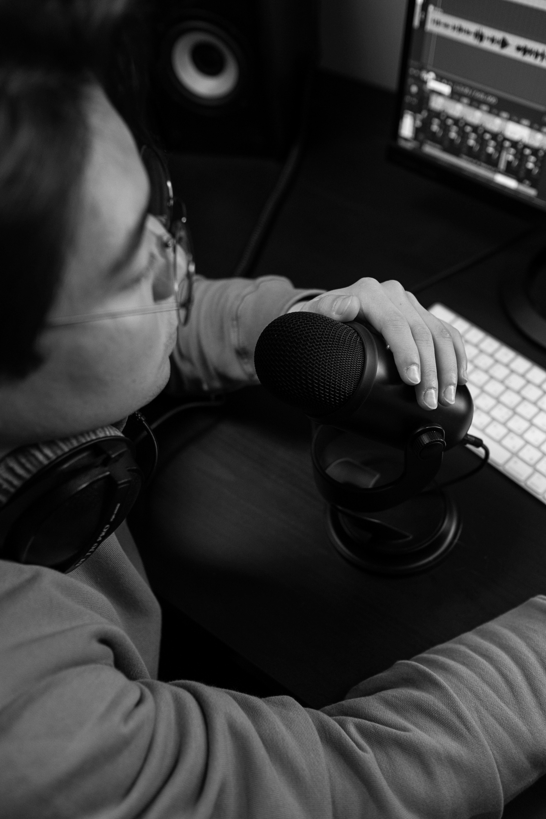
PROPOSED SYSTEM:
Data Collection and Preprocessing
Generator network
Discriminator Network
Training Process
Evaluation and validation
Integration and deployment

Slide 12
System Approach:
Hardware Requirements:
Software Requirements:
High performance cpu
Gpu accelerator with Cuda support for deep learning computation
RAM and storage capacity
High speed network
Fast storage
Deep Learning Frameworks
Python Programming Language:
Image Processing Libraries
OpenCV
PIL (Python Imaging Library)
Development Environment

Slide 13


ALGORITHM:
Data Preprocessing
Standardize image sizes, apply normalization techniques, and remove noise or artifacts from the dataset.
2.Generator Network:
Define the architecture of the generator network, typically using convolutional layers.
3.Discriminator Network:
Define the architecture of the discriminator network, also using convolutional layers.

Slide 14
4.Adversarial Training:
Train the generator and discriminator networks alternately in an adversarial manner.
5.Evaluation and Validation:
Evaluate the performance of the trained GAN model using metrics such as inception score or FID.
6.Integration and Deployment:I
ntegrate the trained GAN model into applications requiring handwritten recognition, such as document processing or digital note-taking.
7.Feedback Loop and Improvement:
Gather feedback from end-users and system performance metrics to identify areas for improvement.

Slide 15

Deployment:
1.Model Training:
Train the GAN model on a dataset of handwritten samples using the algorithm outlined earlier.
2.Model Evaluation:
Evaluate the trained GAN model using validation datasets and appropriate evaluation metrics to ensure that it generates realistic handwritten images.
3.Integration:
Integrate the trained GAN model into the target application or system where handwritten recognition is needed. This may involve developing APIs, libraries, or modules to interact with the model.

Slide 16
4.Scalability :
Considerations:Ensure that the deployed system can handle the expected workload and scale efficiently to accommodate increased demand.
5.Real-time Inference:
Optimize the model for real-time performance to enable fast inference of handwritten recognition.
6.Deployment Environment:
Deploy the handwritten recognition system in the target environment, whether it's on-premises or in the cloud.
7.Monitoring and Maintenance:
Implement monitoring tools and processes to track the performance of the deployed system and detect any issues or anomalies.

Slide 17
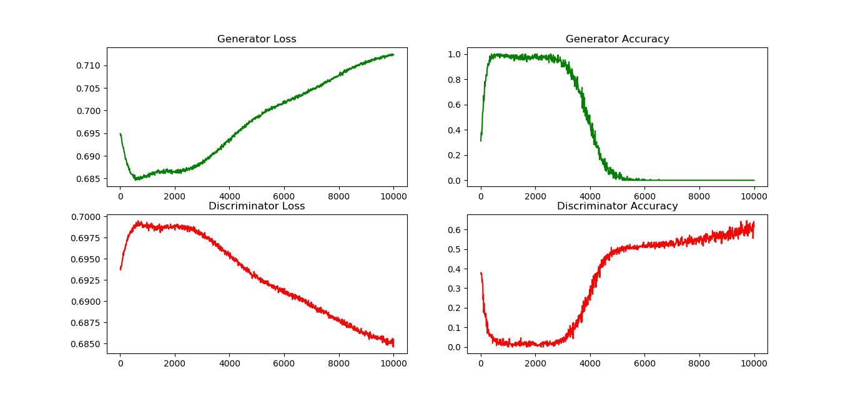
Result:

Slide 18
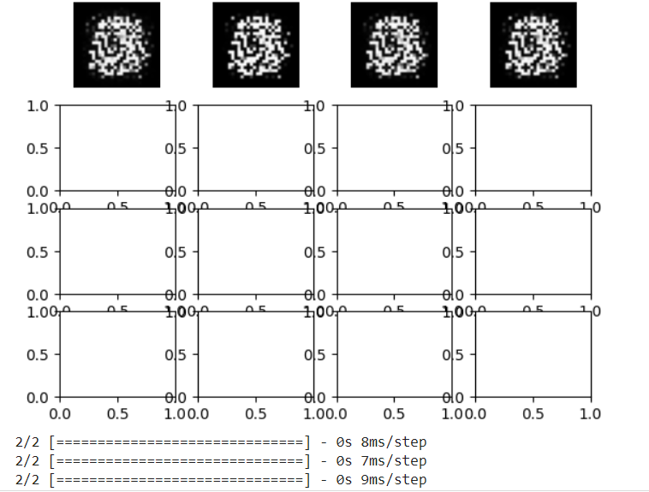
Result:

Slide 19
Conclusion:
In conclusion, deploying a handwritten recognition system using Generative Adversarial Networks (GANs) involves a systematic approach encompassing data preprocessing, model training, integration, scalability considerations, and ongoing maintenance. By following a well-defined algorithm, developers can train and evaluate GAN models to generate realistic handwritten images and integrate them into target applications or systems requiring handwriting recognition capabilities.

Slide 20
Reference:
"Generative Adversarial Nets" by Ian Goodfellow et al. (https://arxiv.org/abs/1406.2661)"Improved Techniques for Training GANs" by Tim Salimans et al. (https://arxiv.org/abs/1606.03498)"Progressive Growing of GANs for Improved Quality, Stability, and Variation" by Tero Karras et al. (https://arxiv.org/abs/1710.10196)

Slide 21
Presented By,
A. Joice Abinaya
3rd year /B.tech (IT)
210921205024
Loyola Institute of Technology,
palanchur Chennai 123.

